Slide 1
Introduction to Data Mining
HDA Workshop
Khawar Naveed Bhatti, MBA Lecturer in Operational Research & Business Analytics

Slide 2
Lecture Outline
Introduction to data mining
Data mining approaches
Classification
k-NN
Discriminant analysis

Slide 3
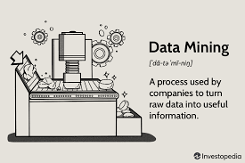
Data Mining
Data mining is focused on better understanding of characteristics and patterns among variables in large databases using a variety of statistical and analytical tools.
It is used to identify relationships among variables in large data sets and understand hidden patterns that they may contain.
Used by most businesses to predict future occurrences and make well informed decisions.

Slide 4
Data mining approaches
Classification
Analyzing data to predict how to classify a new data element.
Data exploration and reduction
Cluster Analysis: identifying groups in which elements are in some way similar.
Association
Analyzing databases to identify natural associations among variables and create rules for target marketing or buying recommendations.
Cause-and-effect-modelling
Developing analytic models to describe relationships between metrics that drive business performance.

Slide 5

Euclidean Distances
Euclidean distance is the straight-line distance between two points.
Assume that the values of the predictors of two records X and Y are labeled (x₁, x₂, … , x_{n}) and (y₁, y₂, … ,y_{n})
The Euclidean distance measure between the two records is:
In Excel, you can use this formula to compute the Euclidean distance:
SQRT(SUMXMY2(array1, array2))
$$\sqrt{(x_{1}−y_{1})^{2}+(x_{2}−y_{2})^{2}+...+(x_{n}−y_{n})^{2}}$$

Slide 6
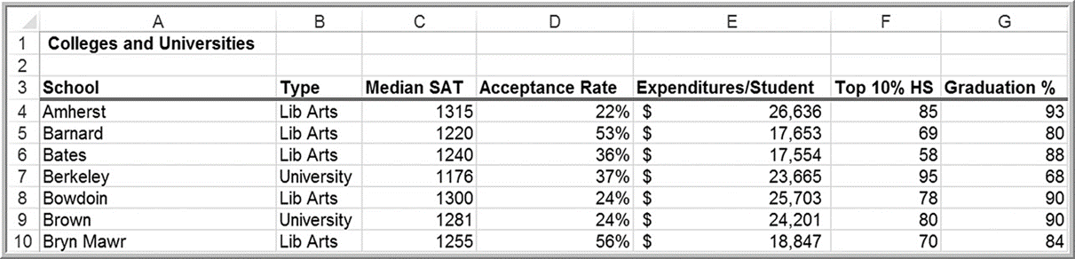
Euclidean Distances example
Colleges and Universities
The distance between Amherst and Barnard is

Slide 7
Normalizing distance measures
Predictors often have different scales
E.g., percentages (25%) versus currency amounts (£11,320)
So they need to be standardized before computing the distance.
To normalize the predictor values, use the formula:
(value to normalize – average) / standard deviation
Then use the Euclidean Distance formula with the standardized values

Slide 8
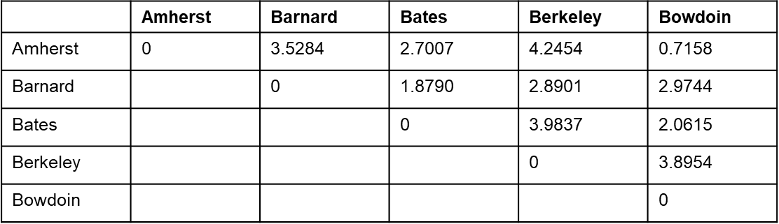
Normalizing distance measures
Normalized distance measure between Amherst and Barnard is

Slide 9

Classification
Classification methods seek to classify a categorical outcome into one of two or more categories based on various data attributes.
For each record in a database, we have a categorical variable of interest and a number of additional predictor variables.
For a given set of predictor variables, we would like to assign the best value of the categorical variable.
Notes:
Similar to the problems attacked by regression analysis but now the dependent variable is categorical. It usually has 2 categories (yes or no) but it can have more than 2.

Slide 10
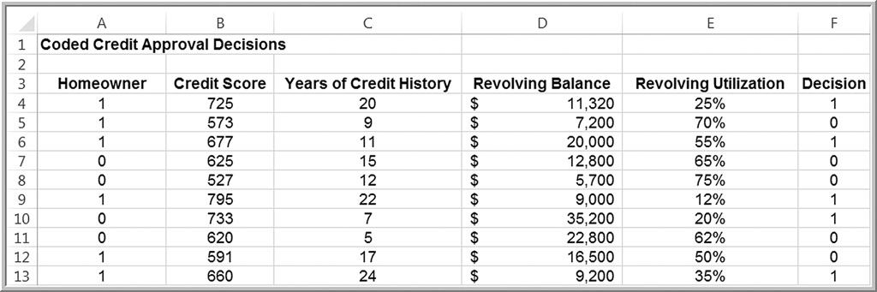
Classification example
Categorical variable of interest: Decision (whether to approve - coded as 1 - or reject -coded as 0 - a credit application).
File name - Credit Approval Decisions.
Predictor variables: shown in columns A - E (note that homeowner is also coded numerically).

Slide 11
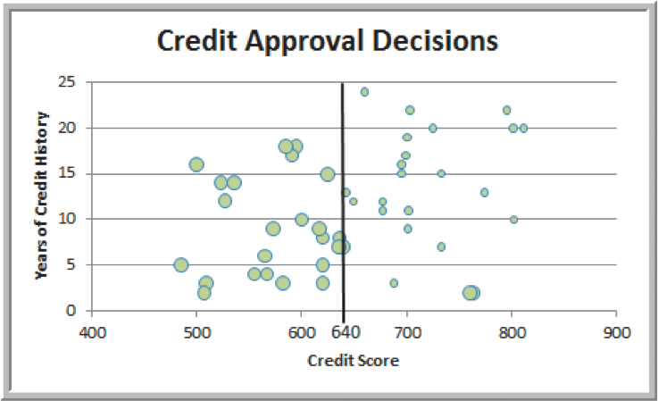
Classifying intuitively
Predictor variables: “credit score” and “years of credit history”
Classification rule: Reject if credit score ≤ 640
Large bubbles correspond to rejected applications.
Two applicants with credit
scores exceeding 640
were rejected.

Slide 12
Measuring classification performance
Find the probability of making a misclassification error and summarize the results in a classification matrix
The classification matrix basically shows the number of cases that were classified either correctly or incorrectly.
Actual Classification | Predicted classification: Decision=1 | Predicted classification: Decision=0
Decision=1 | 23 | 2
Decision=0 | 0 | 25
Probability of a misclassification =

Slide 13
K-Nearest Neighbors (k-NN)
k-NN attempts to find records in a database that are similar to one we wish to classify. Similarity is based on the “closeness” of a record to numerical predictors in the other records, using normalized Euclidean distances.
If k = 1, then the 1-NN rule classifies a record in the same category as its nearest neighbor.
k-NN rule finds the k-Nearest Neighbors to each record we want to classify and assigns the classification as the classification of majority of the k nearest neighbors.
The choice of k is somewhat arbitrary.
Typically, values between 1 and 20 are used, depending on the size of the dataset
and odd numbers are often used to avoid ties in computing the majority classification of the nearest neighbors.

Slide 14
k-NN classification example
Credit Approval Decisions Classification Data
Consider the first new record, 51. If k = 1, the record having the minimum distance from record 51 is record 27. Since the credit decision was to approve, we would classify record 51 as an approval
If k =5, we need to look at the 5 nearest records. These are 27, 7, 46, 3 and 17. For the majority of these (4 out of 5), the credit decision was to approve. Therefore, we would classify record 51 as an approval.
In Excel, to find the k^{th} minimum distance, use the formula =SMALL(array, k).
To find the associated record, use the MATCH function.
Nearest Neighbors for classifying record 51
k | Distance |  | Record | Decision
1 | 0.16504 |  | 27 | Approve
2 | 0.40185 |  | 7 | Approve
3 | 0.49450 |  | 46 | Approve
4 | 0.55615 |  | 3 | Approve
5 | 0.68652 |  | 17 | Reject

Slide 15
Discriminant Analysis
A technique for classifying a set of observations into predefined classes.
The purpose is to determine the class of an observation based on a set of predictor variables.
With only two classification groups, we can apply regression analysis. When, there are more than two, linear regression cannot be applied, and special software must be used.
The estimated value of the decision variable is called a discriminant score.

Slide 16
Discriminant Analysis example
For the credit-approval data, model the decision (approve or reject) as a function of the other variables.
Use the following regression model, where Y represents the decision (0 or 1):

Slide 17
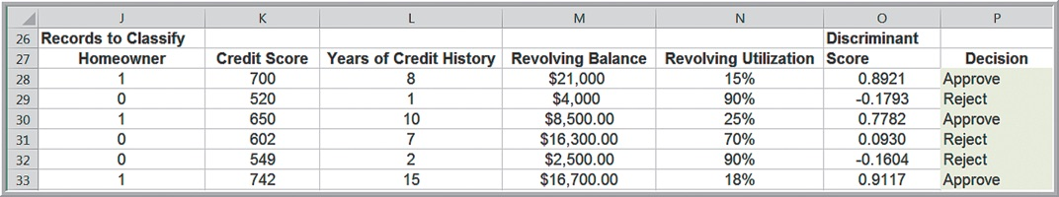
Discriminant Analysis example cont.
Rule for classifying observations using the discriminant scores.
Compute a cut-off value so that if a discriminant score is less than or equal to it, the observation is assigned to one group; otherwise, it is assigned to the other group.
One simple way is to use the midpoint of the average discriminant scores:
Cut-Off value

